Slide 1
Team 12
KEHU
Yefei Fan, Spencer Glass, Tariq Haque, Liya Zhang

Slide 2

Agenda
Background
Mission Statement
Database Design
Application
Notes:
Spencer

Slide 3

Background
Who are our users?
Medium-sized local consulting firms that do business consulting for local restaurants
What is our data like and where does it come from?
In our hypothetical: a consulting business has collected real human reviews about restaurants but doesn’t know how to process
In real life: it is real world Yelp review data
Notes:
Spencer

Slide 4

To leverage user-generated data to develop analytical solutions that will allow clients to improve sales effectiveness.
Notes:
Spencer

Slide 5
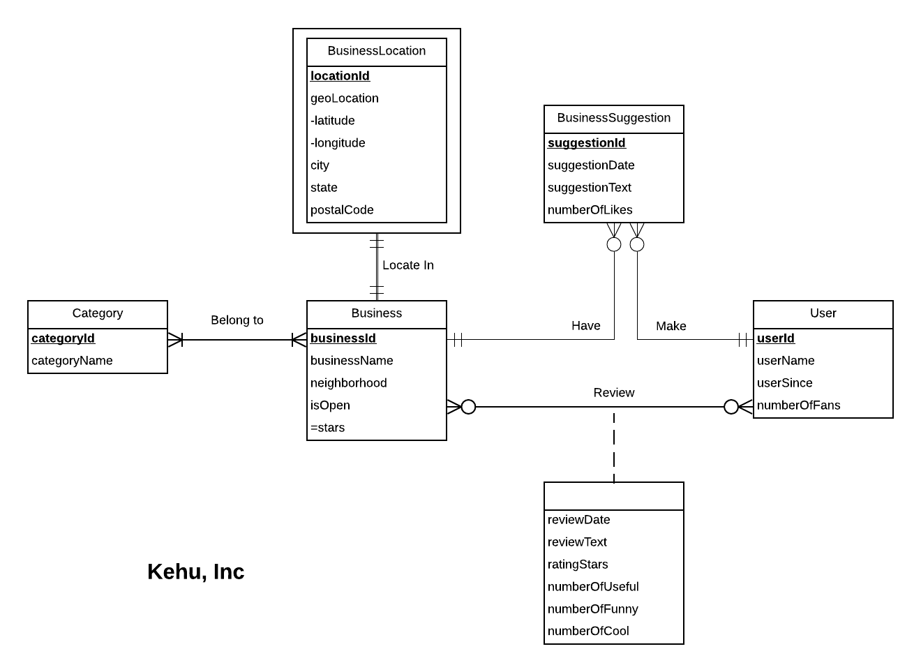

ER Diagram
Notes:
Do we need to change the name on this diagram to KeHu?
Spencer - Many to Many binary between user and business, weak entity business location, and review relationship has attributes

Slide 6

Relational Schema
Category (categoryId, categoryName) = 3NF
BusinessCategory (businessId, categoryId) = 3NF
Business (businessId, businessName, neighborhood, isOpen) = 3NF
BusinessLocation (locationId, businessId, latitude, longitude, address, city, state, postalCode) = 3NF
BusinessSuggestion (suggestionId , businessId, userId, suggestionDate, suggestionText, numberofLikes) = 3NF
Review (userId, businessId, reviewDate, reviewText, reviewRating, numberOfUseful, numberOfFunny, numberOfCool) = 3NF
User (userId, userName, userSince, numberofFans) = 3NF
Notes:
Do we need to change the name on this diagram to KuHu?
Yefei

Slide 7

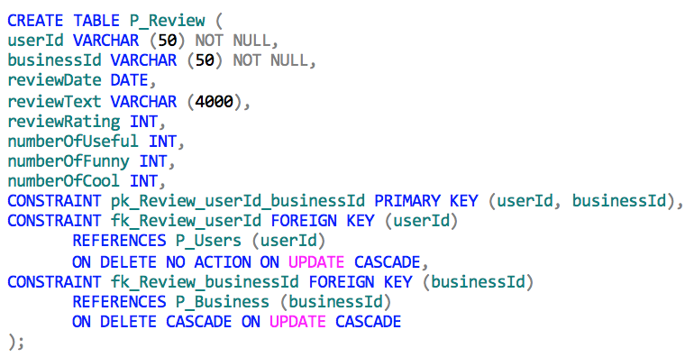

Physical Database Design Example
Notes:
Yefei

Slide 8
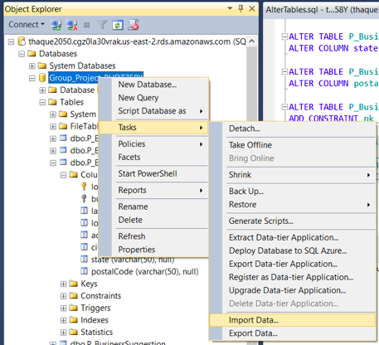
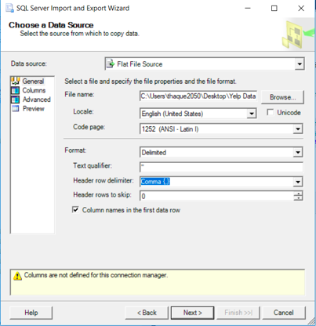
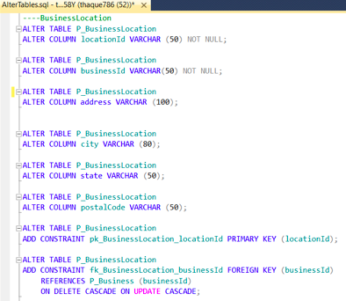



Insert Data
Notes:
Yefei

Slide 9
Mission Objectives
Find customer by name or category
Find out the top rated restaurants/competitors near the customer
Find reviews of a customer and categorize customer reviews by Positive (Rating>2.9) and Negative (<2.01) and use the overall score to draw a pie chart
Use R to build word network of customer’s review
Use R to build a predictive model and identify sentiment score for each sentence in a review by customers; use the score draw a pie chart
Find reviews of competitors
Use R to build word network of competitors review
Use R to build a predictive model and identify sentiment score for each sentence in a review by competitors; use the score draw a stack chart
Insert a new business detail
Delete a business from the database
Notes:
Liya

Slide 10

Created Views To Speed up Data Fetching
#1 Brief_BusinessDetails_V
CREATE VIEW Brief_BusinessDetails_V AS
SELECT p.businessId,p.businessName,c.categoryName
FROM P_Business p, P_BusinessCategory bc, P_Category c
WHERE p.businessId=bc.businessId AND bc.categoryId=c.categoryId AND (c.categoryName='Chinese' OR c.categoryName='Italian’ OR c.categoryName='Mexican' OR c.categoryName='American');
#2 Business_Reviews_Details_V
CREATE VIEW Business_Reviews_Details_V AS
SELECT p.businessId, p.businessName, r.reviewText, r.reviewDate,r.reviewRating
FROM P_Business p JOIN P_Review r ON p.businessId=r.businessId;
Notes:
Liya

Slide 11

CREATE VIEW Business_Competitor_Word_V AS
SELECT p.businessName,p.businessId, c.categoryName,r.reviewText
FROM P_Business p JOIN P_Review r ON p.businessId=r.businessId JOIN P_BusinessCategory bc ON p.businessId=bc.businessId JOIN P_Category c ON c.categoryId=bc.categoryId
WHERE c.categoryName = 'Chinese' OR c.categoryName='Mexican' OR c.categoryName='Italian' OR c.categoryName = 'American';
Created Views
#4
#3
CREATE VIEW Competitor_Business_Details_V AS
SELECT *
FROM
(SELECT dd.businessId, dd.businessName,dd.categoryName,dd.reviewText,cc.Average_Rating,dd.reviewRating, dd.longitude, dd.latitude
FROM
(SELECT p.businessId, p.businessName,c.categoryName,r.reviewText,r.reviewRating, bl.longitude, bl.latitude
FROM P_Business p JOIN P_Review r ON p.businessId=r.businessId JOIN P_BusinessCategory bc ON p.businessId=bc.businessId JOIN P_Category c ON c.categoryId=bc.categoryId JOIN P_BusinessLocation bl ON bl.businessId=p.businessId) dd
JOIN
(SELECT AVG(reviewRating) AS Average_Rating ,businessId
FROM P_Review GROUP BY businessId) cc
ON cc.businessId=dd.businessId) kk
WHERE kk.categoryName = 'Chinese' OR kk.categoryName = 'American' OR kk.categoryName = 'Mexican' OR kk.categoryName = 'Italian';
Notes:
Liya

Slide 12

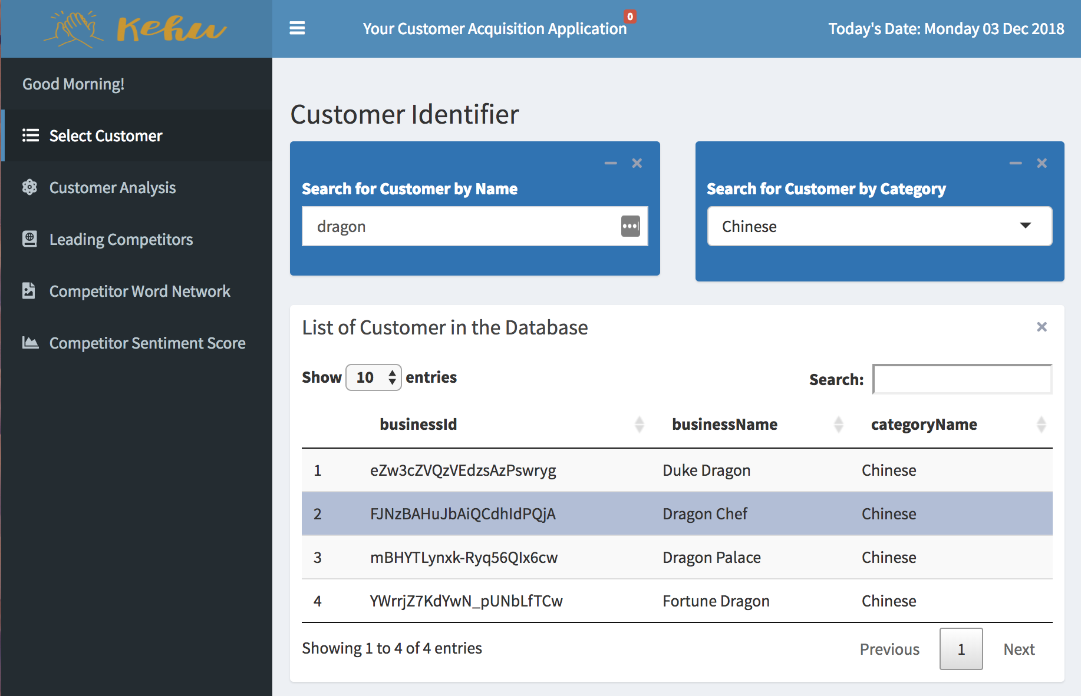

Use Case 1: Fetch Customer by Name and Category
Input
SELECT businessId, businessName, categoryName
FROM Brief_BusinessDetails_V
WHERE businessName LIKE '%Dragon%' AND
categoryName='Chinese';
Step
# 1: Call View 1 from the Database and Get “Table1”
# 2: Filter “Table1” by inputting “customer name” and “customer category” in the application interface
# 3: Output Table resulting from step 2
Notes:
Tariq

Slide 13
Use Case 2: Top Rated Competitors Near a Customer
SELECT *
FROM
(SELECT TOP 5 *
FROM
(SELECT businessId, AVG(pp.Average_Rating) AS Avg_Rating, AVG(pp.DISTANCE) AS Distance
FROM
(SELECT *, (111.111 * DEGREES(ACOS(COS(RADIANS(llatitude))*COS(RADIANS(latitude))*
COS(RADIANS(llongitude - longitude))+ SIN(RADIANS(llatitude))*
SIN(RADIANS(latitude))))) AS DISTANCE
(SELECT *
FROM Competitor_Business_Details_V a
JOIN
(SELECT AVG(longitude) AS llongitude, AVG(latitude) AS llatitude
FROM Competitor_Business_Details_V
WHERE businessId='FJNzBAHuJbAiQCdhIdPQjA'
GROUP BY longitude, latitude) d
ON a.businessId=a.businessId) kk
WHERE kk.businessId=kk.businessId) pp
GROUP BY businessId) qq
ORDER BY qq.Avg_Rating DESC) ll
WHERE ll.Distance<8;
#5
Select Top 5 entries by average rating
#4
Group by business Id so that we have
only one row for a businessId
#3
Add distance as a column
#2
Add the constant values as columns for
longitude and latitude to calculate distance
#1
Filter longitude and latitude of customer
#6
Filter by distance
Notes:
Tariq

Slide 14
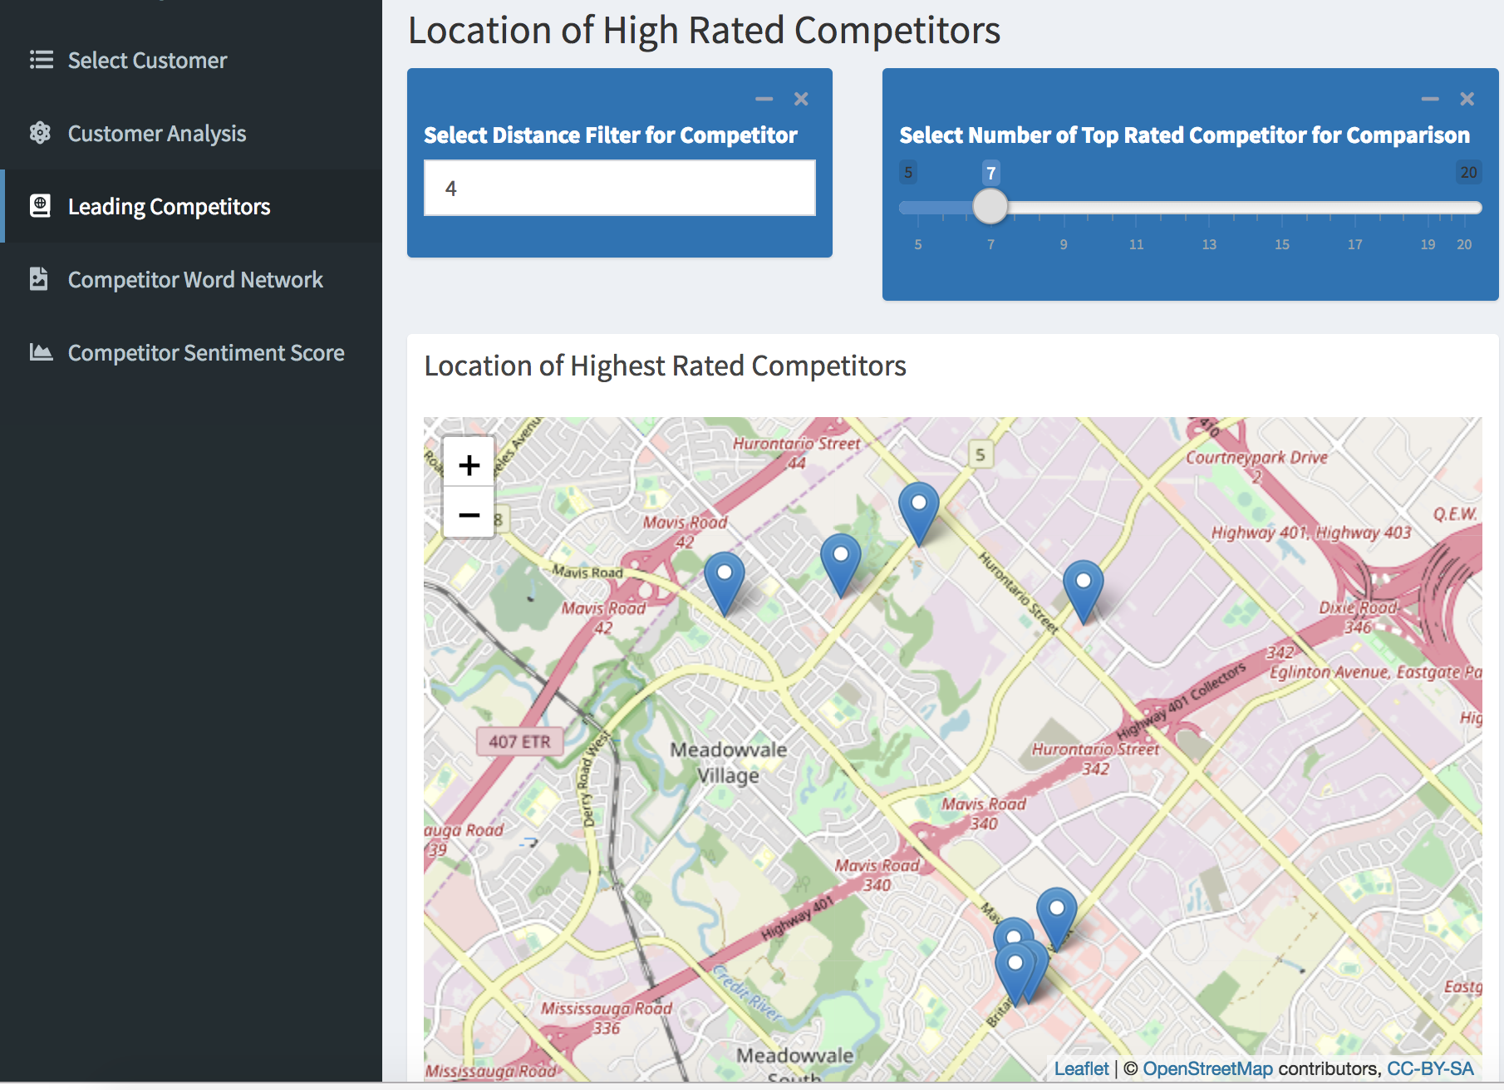


Use Case 2: Top Rated Competitors Near a Customer
#1: Use SQL to find out top rated competitors within a certain distance of the customer
#2: Use leaflet in R to plot the results based on longitude and latitude of the restaurants (competitors and customer)
Notes:
Tariq

Slide 15
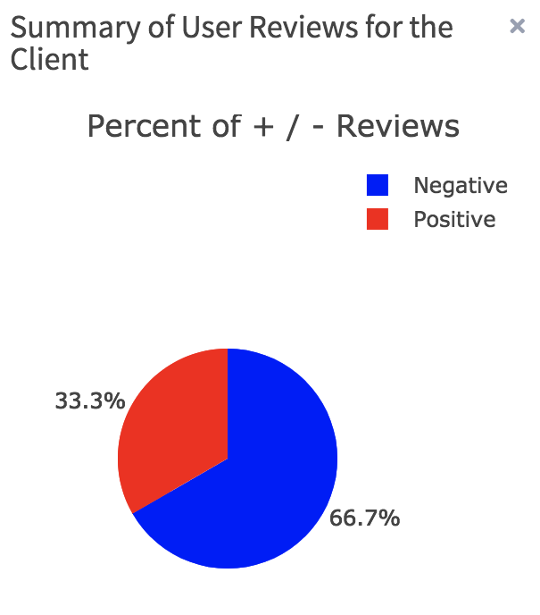
Use Case 3: Share of Positive and Negative Reviews for Customers
SELECT *, ROUND((CAST(aa.Num_Positive AS DECIMAL(4,2))/(CAST(aa.Num_Positive AS DECIMAL(4,2))+CAST(bb.Num_Negative AS DECIMAL(4,2))))*100, 2) AS Percent_Positive,
ROUND((CAST(bb.Num_Negative AS DECIMAL(4,2))/(CAST(aa.Num_Positive AS DECIMAL(4,2))+CAST(bb.Num_Negative AS DECIMAL(4,2))))*100, 2) AS Percent_Negative
FROM
(SELECT COUNT(*) AS Num_Positive, businessId
FROM Business_Reviews_Details_V
WHERE businessId='FJNzBAHuJbAiQCdhIdPQjA' AND reviewRating>2.9
GROUP BY businessId) aa
JOIN
(SELECT COUNT(*) AS Num_Negative, businessId
FROM Business_Reviews_Details_V
WHERE businessId='FJNzBAHuJbAiQCdhIdPQjA' AND reviewRating<2.01
GROUP BY businessId) bb
ON aa.businessId=bb.businessId;

Slide 16


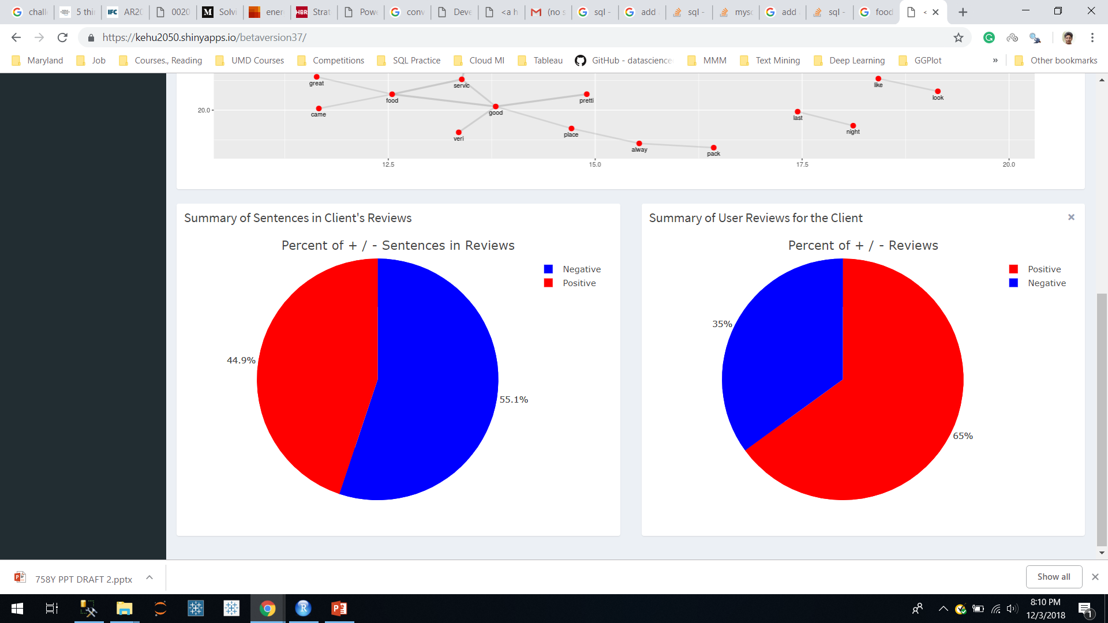

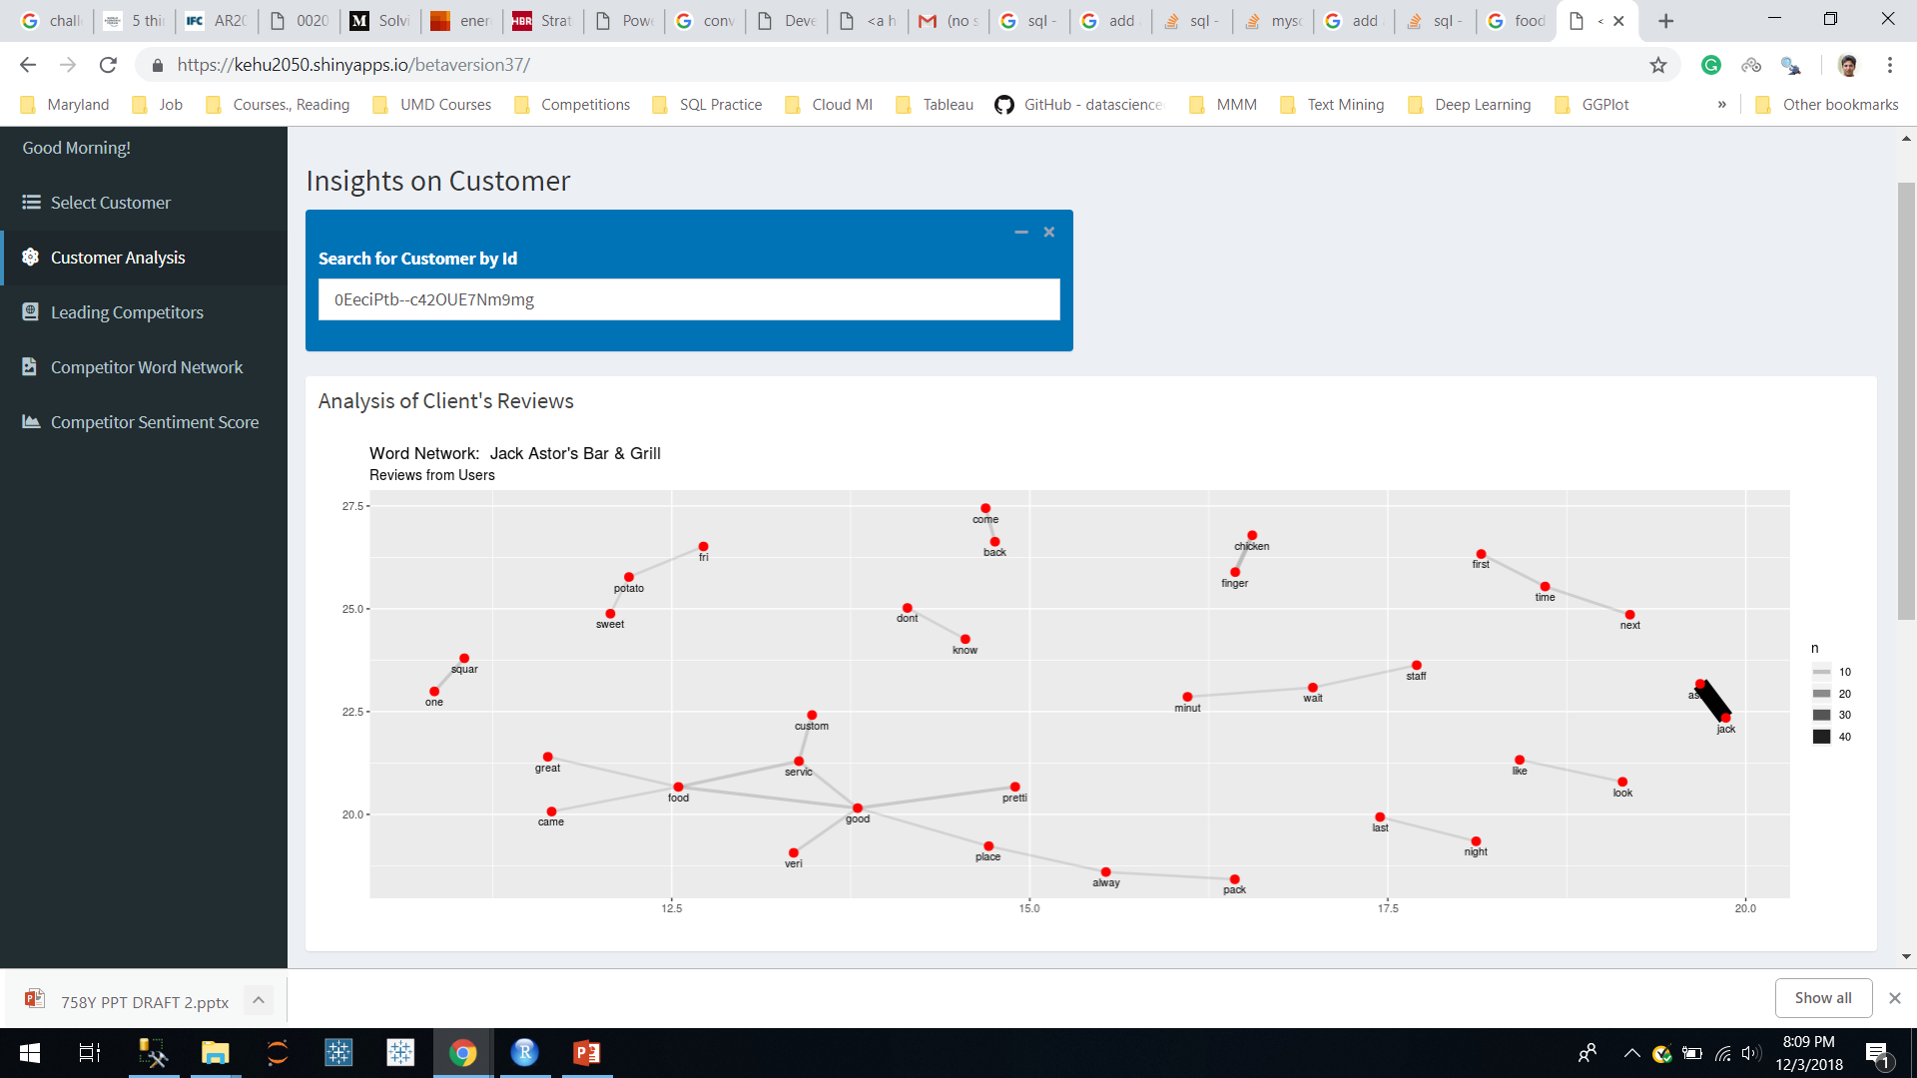
Use Case 3 (R): Build a word network and predictive model
Run SQL query to get reviews of the customer
SELECT reviewText
FROM Business_Reviews_Details_V
WHERE businessId='FJNzBAHuJbAiQCdhIdPQjA'
Build a predictive model and rate each sentence in a review as positive or negative and plot the overall score
Use R to build a network of related words
Notes:
Tariq

Slide 17

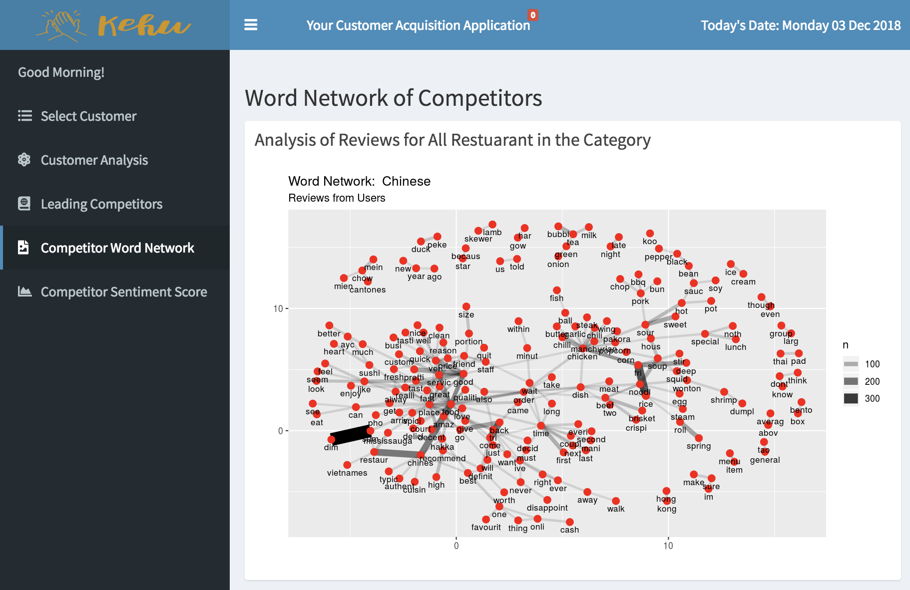

Use Case 4 (R): Use R to build word network of competitors review
#1
Run SQL query to get reviews of competitors
SELECT businessId, reviewText
FROM Business_Competitor_Word_V
WHERE categoryName='Chinese'
#2
Use R to build a network of related words
Notes:
Tariq

Slide 18

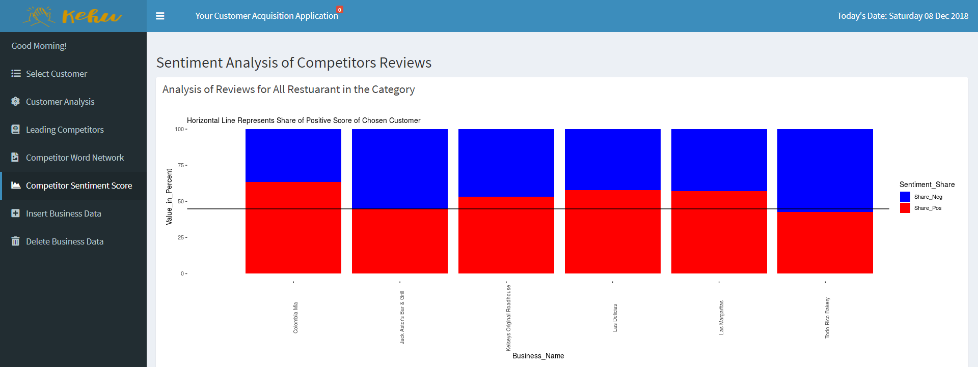
Use Case 4 (R): Build a predictive model and identify sentiment score for each sentence in a review of competitors
#1
Run SQL query to get reviews of competitors
SELECT businessId, reviewText
FROM Business_Competitor_Word_V
WHERE categoryName='Chinese'
#2
Build a predictive model and rate each sentence in a review as positive or negative and plot the overall score
Notes:
Tariq

Slide 19


Application Link
https://kehu2050.shinyapps.io/finalversion22/
Notes:
Tariq - scroll through but only for maybe a minute to quickly just show the front end

Slide 20

BE COOL
USE

